Slide 1
Generative Deep Learning Teaching Machines to Paint, Write, Compose, and Play
2026 Fall
조상구교수

Slide 2
Generative Adversarial Networks

Slide 3
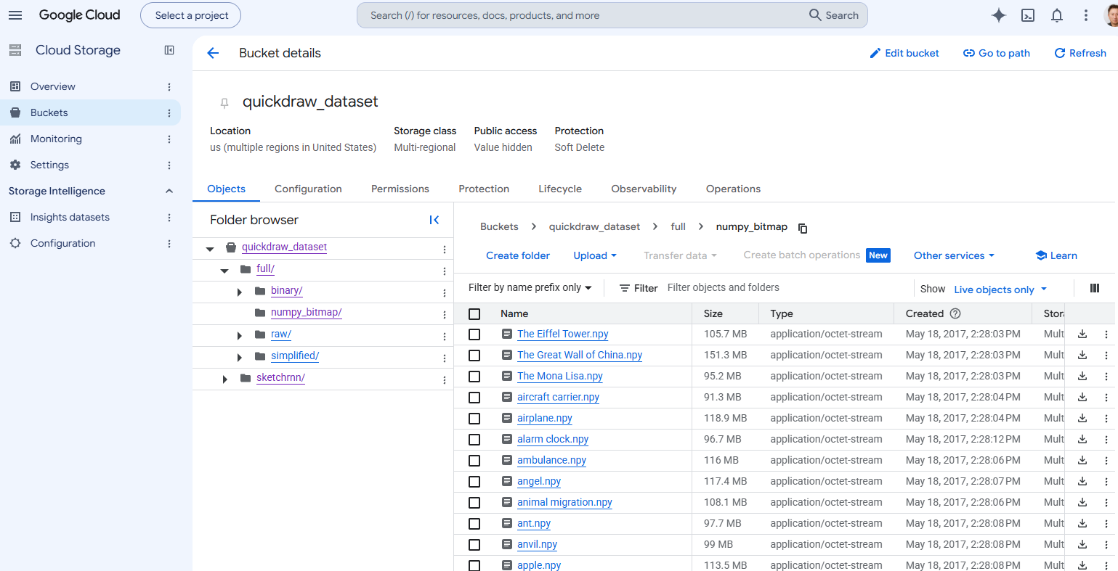
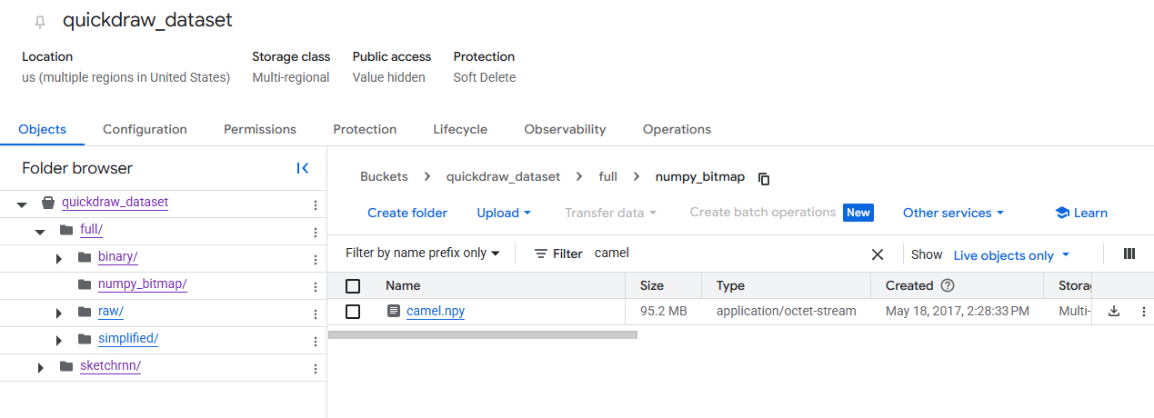
Data for your first GAN
구글의 AI 낙서 맞추기 게임인 'Quick, Draw!'의 공개 데이터셋

Slide 4
Data for your first GAN
D:\>curl -O https://storage.googleapis.com/quickdraw_dataset/full/numpy_bitmap/camel.npy
% Total % Received % Xferd Average Speed Time Time Time Current
Dload Upload Total Spent Left Speed
100 90.76M 100 90.76M 0 0 9.39M 0 00:09 00:09 10.55M
D:\>dir camel.npy
D 드라이브의 볼륨: DATA
볼륨 일련 번호: BA26-5711
D:\ 디렉터리
2026-09-07 오전 10:32 95,176,896 camel.npy
1개 파일 95,176,896 바이트
0개 디렉터리 486,531,141,632 바이트 남음

Slide 5
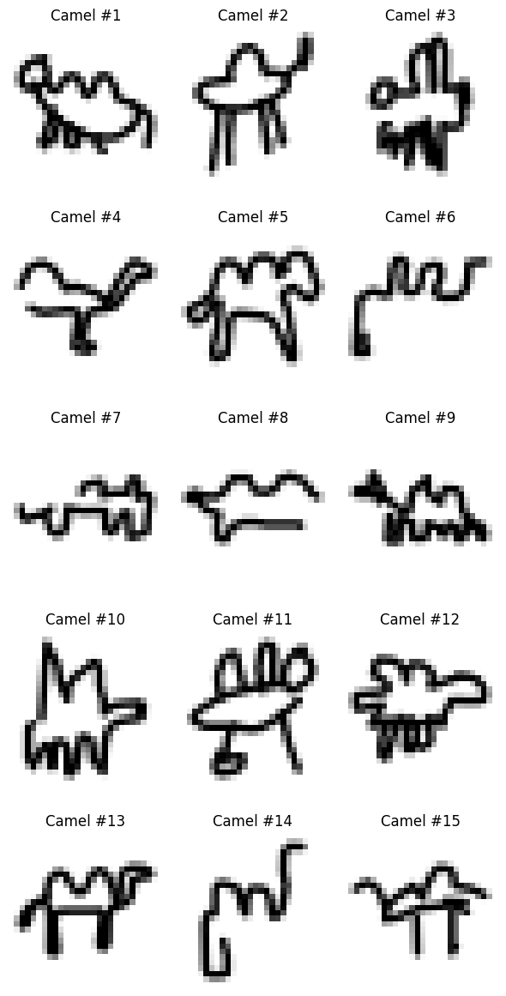
Data for your first GAN
# 1. Colab 환경으로 camel.npy 데이터셋 직접 다운로드
!wget https://storage.googleapis.com/quickdraw_dataset/full/numpy_bitmap/camel.npy
import numpy as np
import matplotlib.pyplot as plt
# 2. .npy 파일 불러오기
camels = np.load('camel.npy')
print("데이터 Shape:", camels.shape) # (샘플 수, 784)
# 3. 샘플 10개를 5행 2열(5 by 2) 그리드로 시각화
fig, axes = plt.subplots(5, 3, figsize=(6, 12))
for i, ax in enumerate(axes.flat):
# 784개 수치 데이터를 28x28 픽셀 이미지로 변환
img = camels[i].reshape(28, 28)
# gray_r: 흰 바탕에 검은색 선으로 표시
ax.imshow(img, cmap='gray_r')
ax.set_title(f'Camel #{i+1}')
ax.axis('off') # 축 눈금 숨기기
plt.tight_layout()
plt.show()

Slide 6
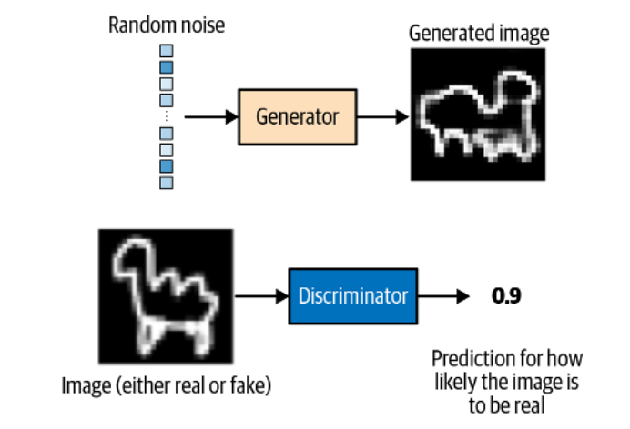
Your First GAN
Inputs and outputs of the two networks in a GAN

Slide 7
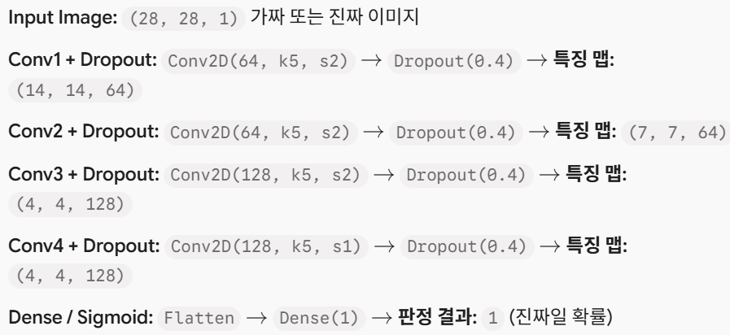
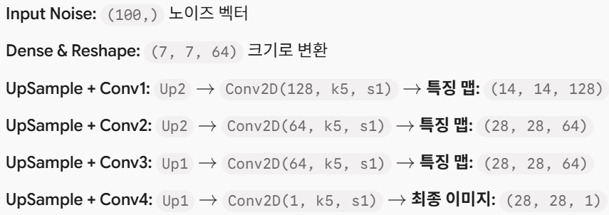
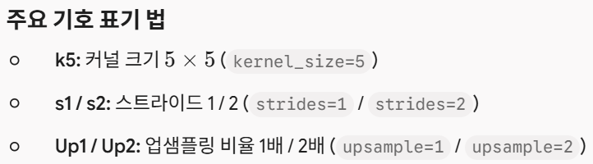
Your First GAN
gan = GAN(input_dim=(28, 28, 1),
discriminator_conv_filters=[64, 64, 128, 128],
discriminator_conv_kernel_size=[5, 5, 5, 5],
discriminator_conv_strides=[2, 2, 2, 1],
discriminator_batch_norm_momentum=None,
discriminator_activation='relu',
discriminator_dropout_rate=0.4,
discriminator_learning_rate=0.0008,
generator_initial_dense_layer_size=(7, 7, 64),
generator_upsample=[2, 2, 1, 1],
generator_conv_filters=[128, 64, 64, 1],
generator_conv_kernel_size=[5, 5, 5, 5],
generator_conv_strides=[1, 1, 1, 1],
generator_batch_norm_momentum=0.9,
generator_activation='relu',
generator_dropout_rate=None,
generator_learning_rate=0.0004,
optimiser='rmsprop',
z_dim=100)

Slide 8
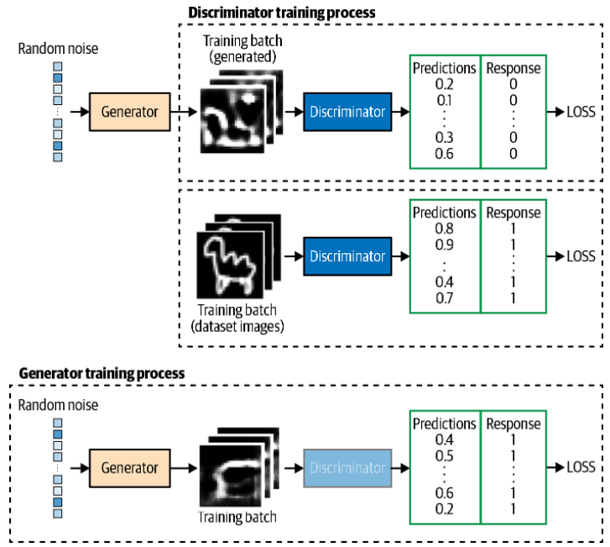
Training GAN

Slide 9
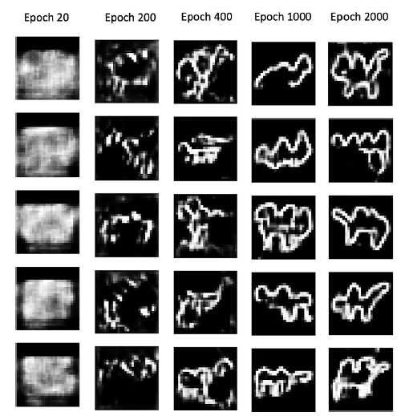
Output from the generator at specific epochs during training

